Slide 1
Routing Protocols

Slide 2
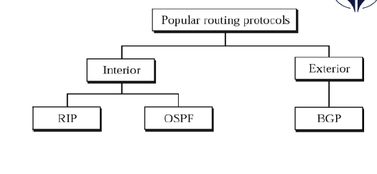
Routing protocols
Routing protocols belong to two main classifications, interior and exterior routing gateways.
These classifications define the way the routing protocols move and share information within large networks.

Slide 3
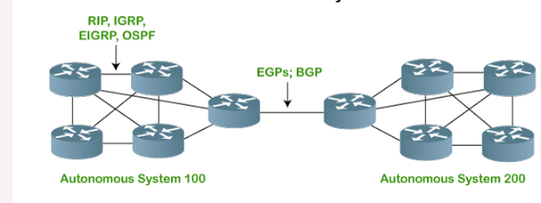
Autonomous System (AS)
The Internet is a network of networks. It is broken up into hundreds of thousands of smaller networks known as autonomous systems
An Autonomous System (AS) is a group of networks under a single administrative control which could be an Internet Service Provider (ISP) or a large Enterprise Organization.

Slide 4
Exterior Gateway Protocols
Exterior Gateway Protocols handle routing outside an Autonomous System
Examples of an EGP:
Border Gateway Protocol (BGP)

Slide 5
Interior Gateway Protocols
Interior Gateway Protocols (IGPs) handle routing within an Autonomous System
IGP's fall into two categories:
Distance Vector Protocols
Routing Information Protocol (RIP)
Interior Gateway Routing Protocol (IGRP)
Link State Protocols
Open Shortest Path First (OSPF)
Intermediate System to Intermediate System (IS-IS)

Slide 6
Routing Information Protocol
Routing Information Protocol (RIP) is a dynamic routing protocol that uses hop count as a routing metric to find the best path between the source and the destination network.

Slide 7
Hop Count
Hop count is the number of routers occurring in between the source and destination network.
The path with the lowest hop count is considered as the best route to reach a network and therefore placed in the routing table.
RIP prevents routing loops by limiting the number of hops allowed in a path from source and destination.
The maximum hop count allowed for RIP is 15 and a hop count of 16 is considered as network unreachable.

Slide 8
Features of RIP
1. Updates of the network are exchanged periodically.
2. Updates (routing information) are always broadcast.
3. Full routing tables are sent in updates.
4. Routers always trust routing information received from neighbor routers. This is also known as Routing on rumors.

Slide 9
How RIP updates its Routing table
The following timers are used to update the routing table:
RIP update timer : 30 sec
RIP Invalid timer : 180 sec
RIP Flush timer : 240 sec
RIP Hold down timer:180 sec

Slide 10
Timers in RIP
The following timers are used to update the routing table:
RIP update timer : 30 sec
The Update timer determines the interval at which the router sends route information .
RIP Invalid timer : 180 sec
If no route information can be received before the Invalid timer times out, the entry is considered to be invalid.
If it does not receive the update within 180 seconds, then it will mark the particular route as not reachable.

Slide 11
Timers in RIP
RIP Flush timer : 240 sec
The Flush timer is a timer for removing RIP entries from the routing table.
If no RIP route can be received before the Flush timer times out, the entry will be removed from the routing table.
Hold down timer: 180 sec
This is the time for which the router waits for a neighbor router to respond. If the router isn’t able to respond within a given time then it is declared dead. It is 180 sec

Slide 12
How Routing Information Protocol (RIP) works
RIP uses a distance vector algorithm to decide which path to put a packet on to get to its destination.
Each RIP router maintains a routing table, which is a list of all the destinations the router knows how to reach.
Each router broadcasts its entire routing table to its closest neighbors every 30 seconds.
The neighbors, in turn, pass the information on to their nearest neighbors, and so on, until all RIP hosts within the network have the same knowledge of routing paths.
This shared knowledge is known as convergence.

Slide 13
How Routing Information Protocol (RIP) works
If a router receives an update on a route, and the new path is shorter, it will update its table entry with the length and next-hop address of the shorter path.
If the new path is longer, it will wait through a "hold-down" period to see if later updates reflect the higher value as well.
It will only update the table entry if the new, longer path has been determined to be stable.
If a router crashes or a network connection is severed, the network discovers this because that router stops sending updates to its neighbors, or stops sending and receiving updates along the severed connection.
If a given route in the routing table isn't updated across six successive update cycles (that is, for 180 seconds) a RIP router will drop that route and let the rest of the network know about the problem through its own periodic updates.

Slide 14
Open Shortest Path First (OSPF)

Slide 15
Open Shortest Path First Protocol (OSPF)
Open Shortest Path First (OSPF) is a link-state routing protocol that
is used to find the best path between the source and the
destination router using its own Shortest Path First.
It is an intradomain protocol, which means that it is used within an
area or a network.
It is based on a link-state routing algorithm in which each router contains the information of every domain, and based on this information, it determines the shortest path.

Slide 16
OSPF Areas
OSPF divides the autonomous systems into areas where the area is a collection of networks, hosts, and routers.
Like internet service providers divide the internet into a different autonomous system for easy management and OSPF further divides the autonomous systems into Areas.
Routers that exist inside the area flood the area with routing information
In Area, the special router also exists.
The special routers are those that are present at the border of an area, and these special routers are known as Area Border Routers.
This router summarizes the information about an area and shares the information with other areas.
All the areas inside an autonomous system are connected to the backbone routers, and these backbone routers are part of a primary area.
The role of a primary area is to provide communication between different areas.

Slide 17
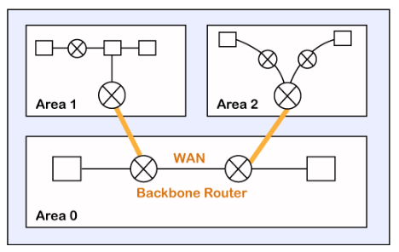
OSPF Areas

Slide 18
How does OSPF work?
There are three steps that can explain the working of OSPF:
Step 1: The first step is to become OSPF neighbors. The two connecting routers running OSPF on the same link creates a neighbor relationship.
Step 2: The second step is to exchange database information. After becoming the neighbors, the two routers exchange the LSDB information with each other.
Step 3: The third step is to choose the best route. Once the LSDB information has been exchanged with each other, the router chooses the best route to be added to a routing table based on the calculation of SPF.

Slide 19
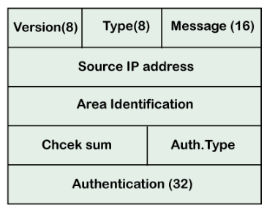
OSPF Message Format

Slide 20
OSPF Message Format
Version: It is an 8-bit field that specifies the OSPF protocol version.
Type: It is an 8-bit field. It specifies the type of the OSPF packet.
There are five different types of packets in OSPF
Hello
Database Description
Link state request
Link state update
Link state Acknowledgment

Slide 21
OSPF Message Format
Version: It is an 8-bit field that specifies the OSPF protocol version.
Type: It is an 8-bit field. It specifies the type of the OSPF packet.
Message: It is a 16-bit field that defines the total length of the message, including the header. Therefore, the total length is equal to the sum of the length of the message and header.
Source IP address: It defines the address from which the packets are sent. It is a sending routing IP address.
Area identification: It defines the area within which the routing takes place.
Checksum: It is used for error correction and error detection.
Authentication type: There are two types of authentication, i.e., 0 and 1. Here, 0 means for none that specifies no authentication is available and 1 means for pwd that specifies the password-based authentication.
Authentication: It is a 32-bit field that contains the actual value of the authentication data.

Slide 22
OSPF states
The device operating OSPF goes through certain states. These states are:
Down
INIT
2WAY
Exstart
Exchange
Loading
Full

Slide 23
OSPF states
Down – In this state, no hello packets have been received on the interface. it means that the OSPF adjacency process has not started yet.
INIT – In this state, the hello packets have been received from the other router.
2WAY – In the 2WAY state, both the routers have received the hello packets from other routers. Bidirectional connectivity has been established.
Exstart – In this state, the master and slave elections take place. The router having the higher router I’d become the master while the other becomes the slave

Slide 24
OSPF states
Exchange – In this state, OSPF routers exchange DataBase Descriptor (DBD) packets. These contain Link State Advertisement (LSA) headers describing the content of the entire Link State Database (LSD)
Loading – In this state, LSR(Link State Reques), LSU(Link State Update), and LSA (Link State Acknowledgement) are exchanged.
Full – Full state is the normal operating state of OSPF that indicates everything is functioning normally

Slide 25
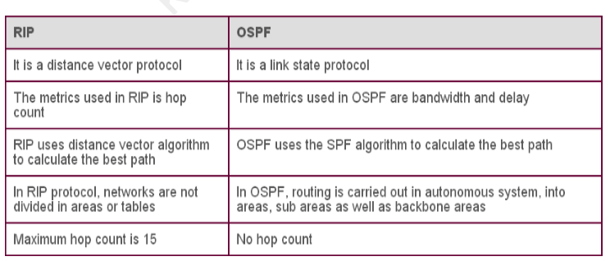
Comparison of RIP and OSPF

Slide 26
Border Gateway Protocol (BGP)

Slide 27
Border Gateway Protocol (BGP)
It is an interdomain routing protocol, and it uses the path-vector routing.
It is a gateway protocol that is used to exchange routing information among the autonomous system on the internet.
Protocol used to communicate between two different autonomous number systems is known as BGP (Border Gateway Protocol).
The BGP is the only protocol that is running on the internet backbone or used to exchange the routes between two different autonomous number systems.

Slide 28
Characteristics of Border Gateway Protocol (BGP):
Inter-Autonomous System Configuration: The main role of BGP is to provide communication between two autonomous systems.
BGP supports Next-Hop Paradigm.
Path Information: BGP advertisement also include path information, along with the reachable destination and next destination pair.
Policy Support: BGP can implement policies that can be configured by the administrator. For ex:- a router running BGP can be configured to distinguish between the routes that are known within the AS and that which are known from outside the AS.
Runs Over TCP.
BGP conserve network Bandwidth.
BGP supports CIDR.
BGP also supports Security.

Slide 29
Types of Autonomous systems
Stub autonomous system
Multihomed autonomous system
Transient Autonomous System

Slide 30
Stub autonomous system
It is a system that contains only one connection from one autonomous system to another autonomous system.
The Stub AS can be either a source or a sink. If we have one autonomous system,
i.e., AS1, then it will have a single connection to another autonomous system, AS2.
The AS1 can act either as a source or a sink. If it acts as a source, then the data moves from AS1 to AS2.
If AS1 acts as a sink, means that the data gets consumed in AS1 which is coming from AS2, but the data will not move forward from AS1.
The data traffic cannot be passed through the stub autonomous system

Slide 31
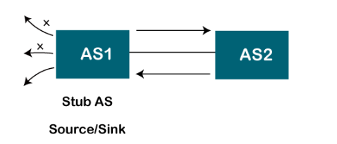
Stub autonomous system

Slide 32
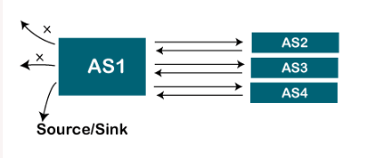
Multihomed autonomous system
It is an autonomous system that can have more than one connection to another autonomous system, but it can still be either a source or a sink for data traffic.
There is no transient data traffic flow, which means that the data can be passed from one autonomous system.

Slide 33
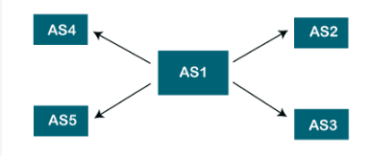
Transient Autonomous System
The transient autonomous system is a multihomed autonomous system, but it also provides transient traffic flow.

Slide 34
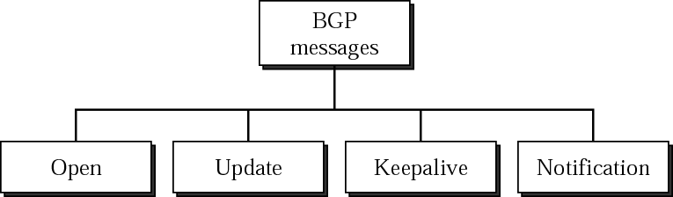
BGP Messages

Slide 35
BGP Messages
OPEN:
UPDATE:
KEEP ALIVE:
NOTIFICATION:

Slide 36
BGP Messages
OPEN:
Opens communications between peers
first message sent by each side after a TCP connection is established
Authenticates sender
UPDATE:
provide routing updates to other BGP systems
Advertises new path (or withdraws old)
KEEP ALIVE:
keep BGP connections, ensures neighbours are still alive or active, keep the sessions from expiring
NOTIFICATION:
notification message is sent when an error condition is detected
used to Close a connection

Slide 37
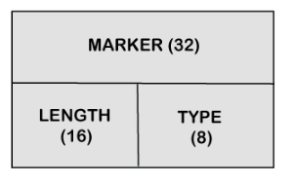
BGP Packet Format
Marker: It is a 32-bit field which is used for the authentication purpose.
Length: It is a 16-bit field that defines the total length of the message, including the header.
Type: It is an 8-bit field that defines the type of the packet.

Slide 38
Path attributes
The BGP chooses the best route based on the attributes of the path.
path-vector routing is used in the border gateway routing protocol, which contains the routing table that shows the path information.
The path attributes provide the path information.
The attributes that show or store the path information are known as path attributes.
This list of attributes helps the receiving router to make a better decision
The path attribute is broadly classified into two categories:

Slide 39
Path attributes
Well-known attribute:
Well-known mandatory:.
Well-known discretionary:
Optional attribute:
Optional transitive:
Optional non-transitive:

Slide 40
Path attributes
Well-known attribute: It is an attribute that should be recognized by every BGP router.
The well-known attribute is further classified into two categories:
Well-known mandatory: When BGP is going to advertise any network,it also advertises extra information.
The information includes AS path information, origin information, next-hop information. Here, mandatory means that it has to be present in all the BGP routing updates.
Well-known discretionary: It is recognized by all the BGP routers and passed on to other BGP routers, but it is not mandatory to be present in an update.

Slide 41
Path attributes
Optional attribute: It is an attribute that is not necessarily to be recognized by every BGP router
The optional attribute is further classified into two categories:
Optional transitive: BGP may or may not recognize this attribute, but it is passed on to the other BGP neighbors. Here, transitive means that if the attribute is not recognized, then it is marked as a partial.
Optional non-transitive: If the BGP cannot recognize the attribute, it ignores the update and does not advertise to another BGP router.

Slide 42
BGP Neighbors
BGP neighborship is similar to the OSPF neighborship, but there are few differences.
BGP forms the neighboring relationship with the help of the TCP connection on port number 179 and then exchanges the BGP updates.
They exchange the updates after forming the neighbor relationship.
In BGP, the neighbor relationship is configured manually.
BGP neighbors are also known as BGP peers or BGP speakers.
There are two types of neighbor relationship:
IBGP (Internal BGP):
EBGP (External BGP):

Slide 43
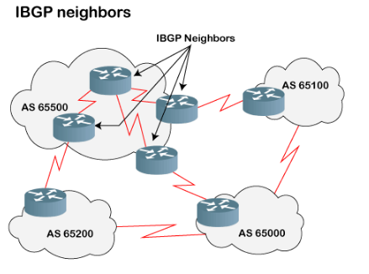
IBGP (Internal BGP):
If all the routers are neighbors of each other and belong to the same autonomous number system, the routers are referred to as an IBGP.

Slide 44
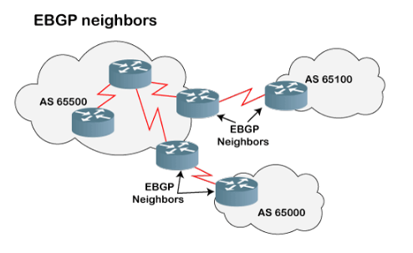
EBGP (External BGP):
If all the routers are neighbors of each other and they belong to the different autonomous number systems, then the routers are referred to as an EBGP.

Slide 45
BGP Tables
There are three types of BGP tables:
Neighbor table:
It contains the neighbors who are configured by the administrator manually.
BGP forwarding table:
It contains all the routes advertised in BGP
IP routing table:
The IP routing table contains the best path routes required to reach the destination

